Slide 1

Data Analysis Techniques in Sports
SE7033 – Theory of Sport Analytics
University of East London

Slide 2
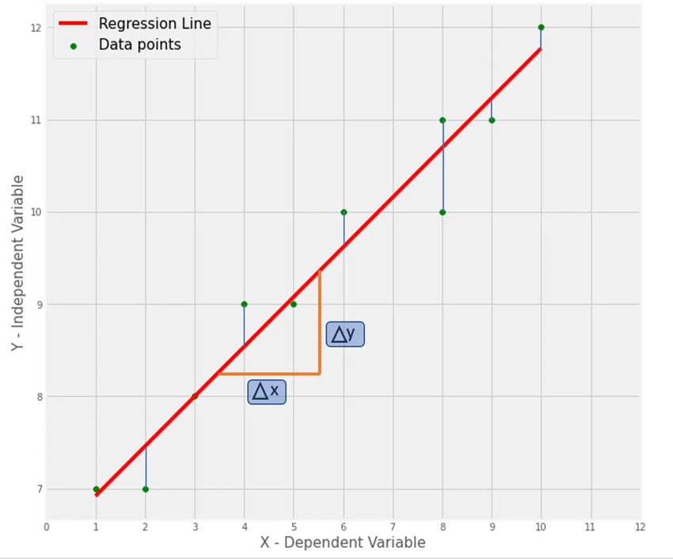
What is Sports Analytics? Sports analytics is the art and science of applying data analysis techniques to the sports industry, aimed at improving player performance and achieving competitive advantage. It involves the systematic computational analysis of sports-related data. (Catapult, 2024)
Linear Regression
Principal Component Analysis (PCA)
Neural Networks
Techniques used for Data Analysis in Sports
Application of Data Analysis in Sports:
Performance Optimization: Coaches use data on player movements, speed, and passing accuracy to refine tactics and player roles.
Injury Prevention: Analyzing player workload and biometric data helps predict injury risks and schedule recovery times.
Recruitment and Scouting: Clubs assess player data to identify potential talent that fits team needs.
Fan Engagement: Teams analyze fan preferences and behavior, tailoring engagement strategies to improve the overall fan experience.

Slide 3
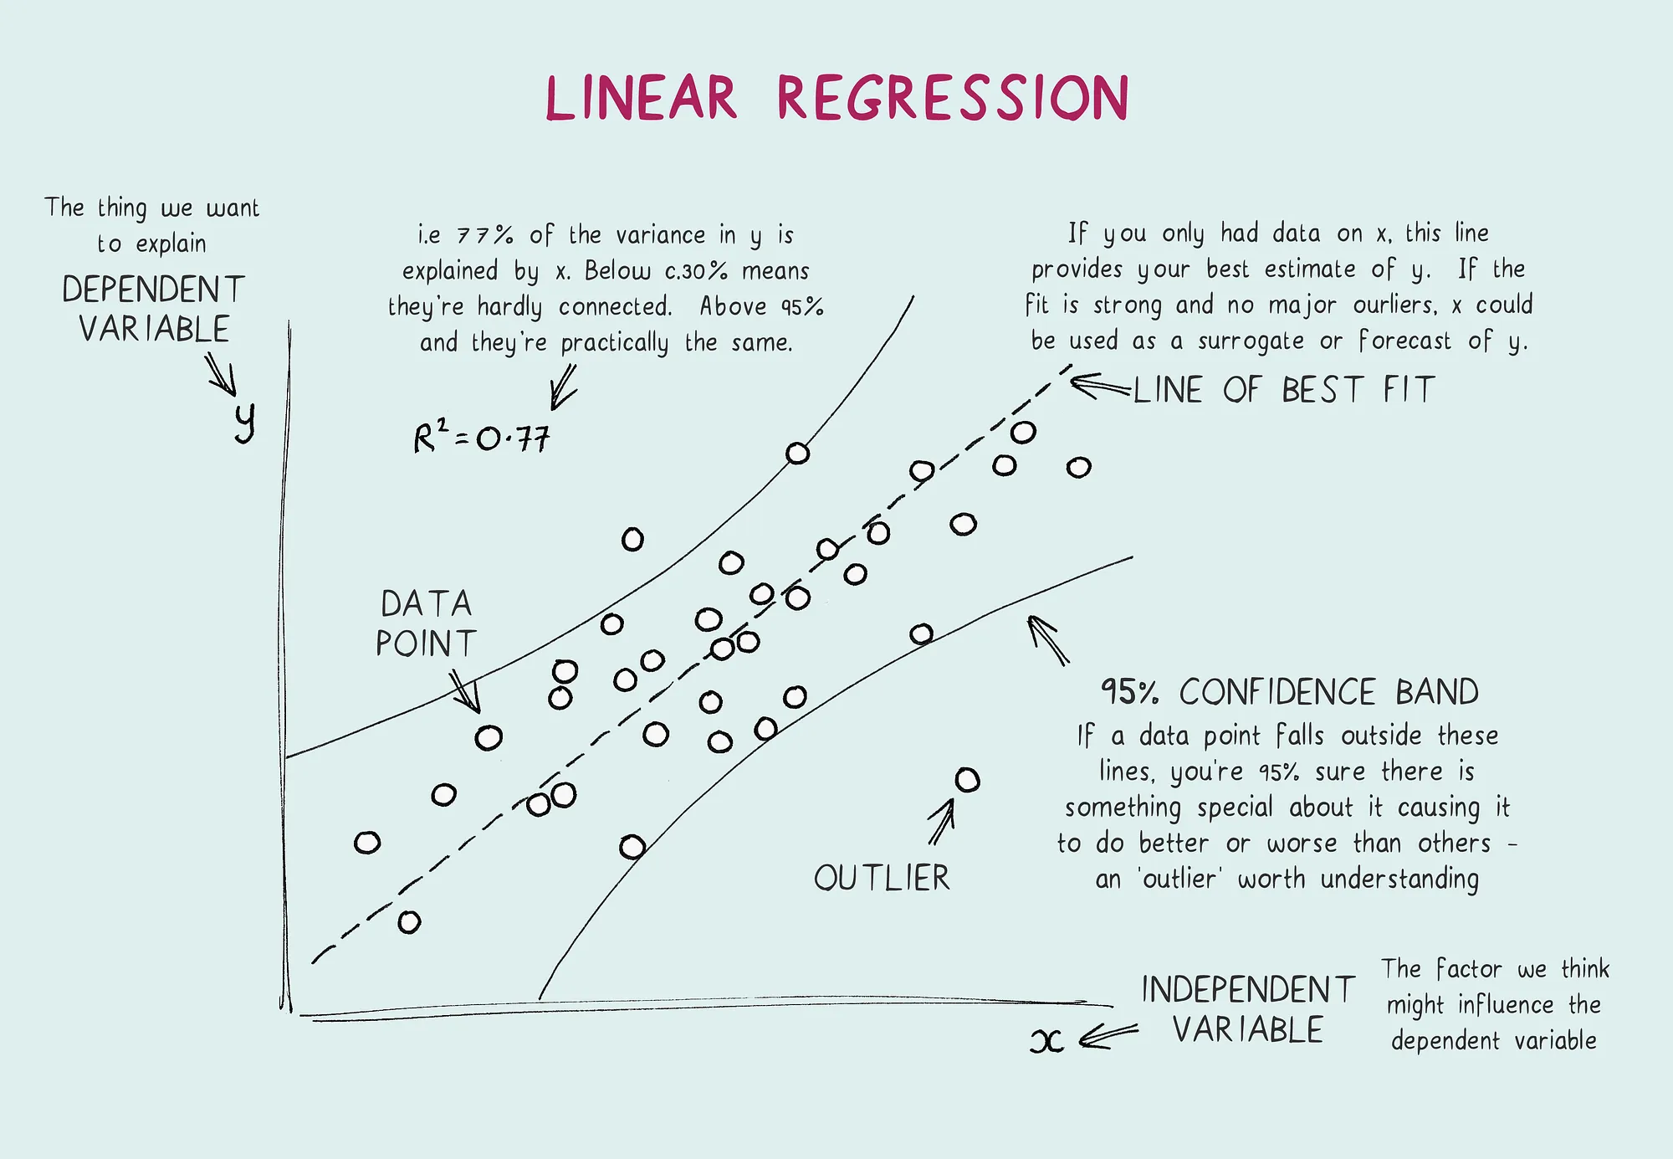
Linear Regression
Linear regression is defined as a statistical technique used for modelling the relationship between a dependent variable (the outcome we want to predict, like attendance or player performance) and one or more independent variables (predictors like player statistics or team ranking) by fitting a linear equation to the data. (Kologlu, 2018)
Formula: y = mx + c Where {m} is the slope and {c} is the y – intercept (Wong, 2021).
Figure 1. (Wong, 2021)
Linear Regression
PCA
Neural Networks
Conclusion

Slide 4
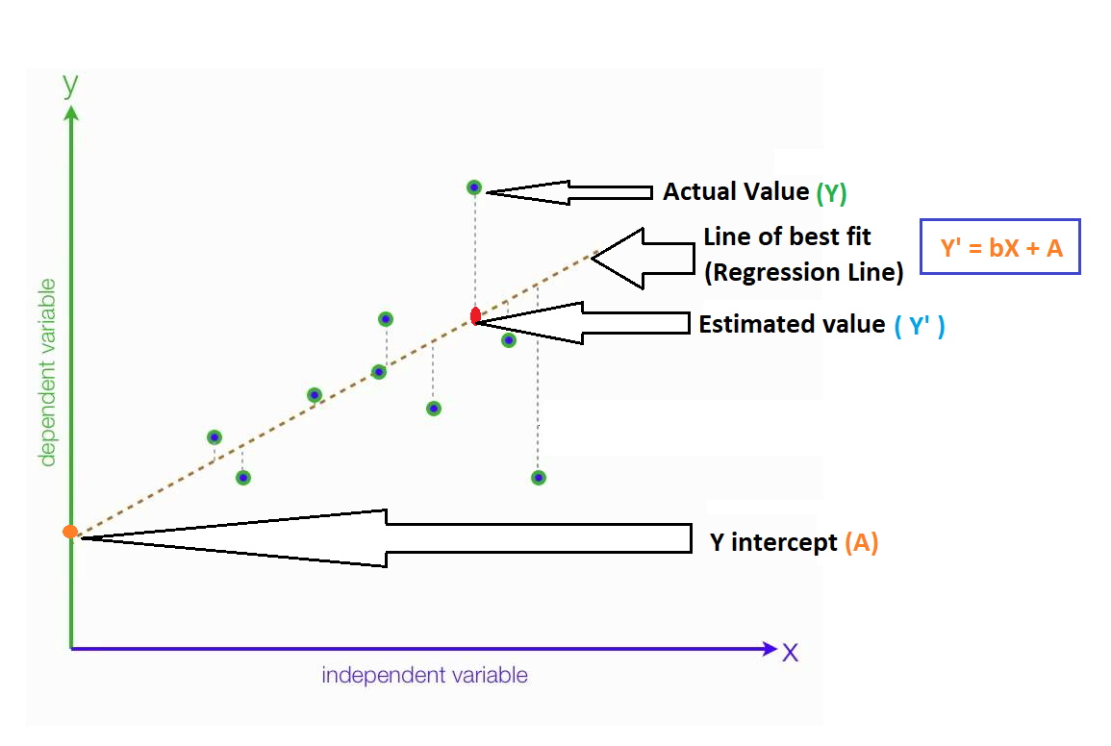
Linear Regression
The distance between the actual data point and the predicted line is called ‘error’ or ‘residual’.
The best-fit line is a line that has the least error which means the error between predicted values and actual values should be minimum (Kavita, 2024).
Mathematically, you obtain the best-fit line by minimizing the Residual Sum of Squares (RSS).
Figure 2. (Gopalan, 2020)

Slide 5
Linear Regression
Importance
Limitations
Simplicity and interpretability Easy understanding and application. Easier to explain.
Building block for other techniques A good foundation for other machine learning methods and data science.
Prediction Allows you to predict future values based on existing data.
Applicability A versatile tool for various fields.
Struggles with non-linear data May not hold in complex data.
Outlier sensitive Can disproportionately affect the accuracy of predictions.
Lack of Dynamic Adaptability For eg, a player’s performance can drastically change due to a recent injury or change in formation.

Slide 6
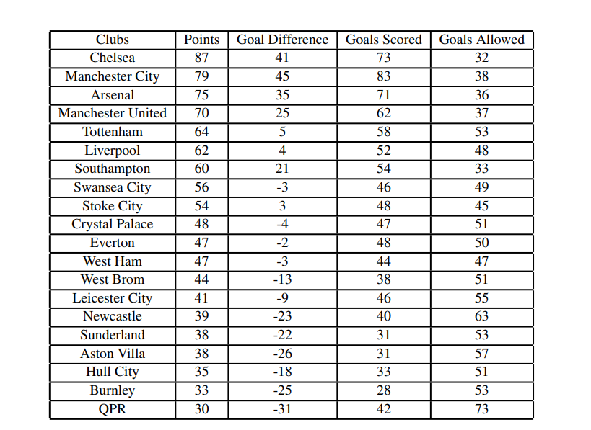

Linear Regression Dataset
Figure 3. Premier League table from 2014-25 season
Figure 4.

Slide 7
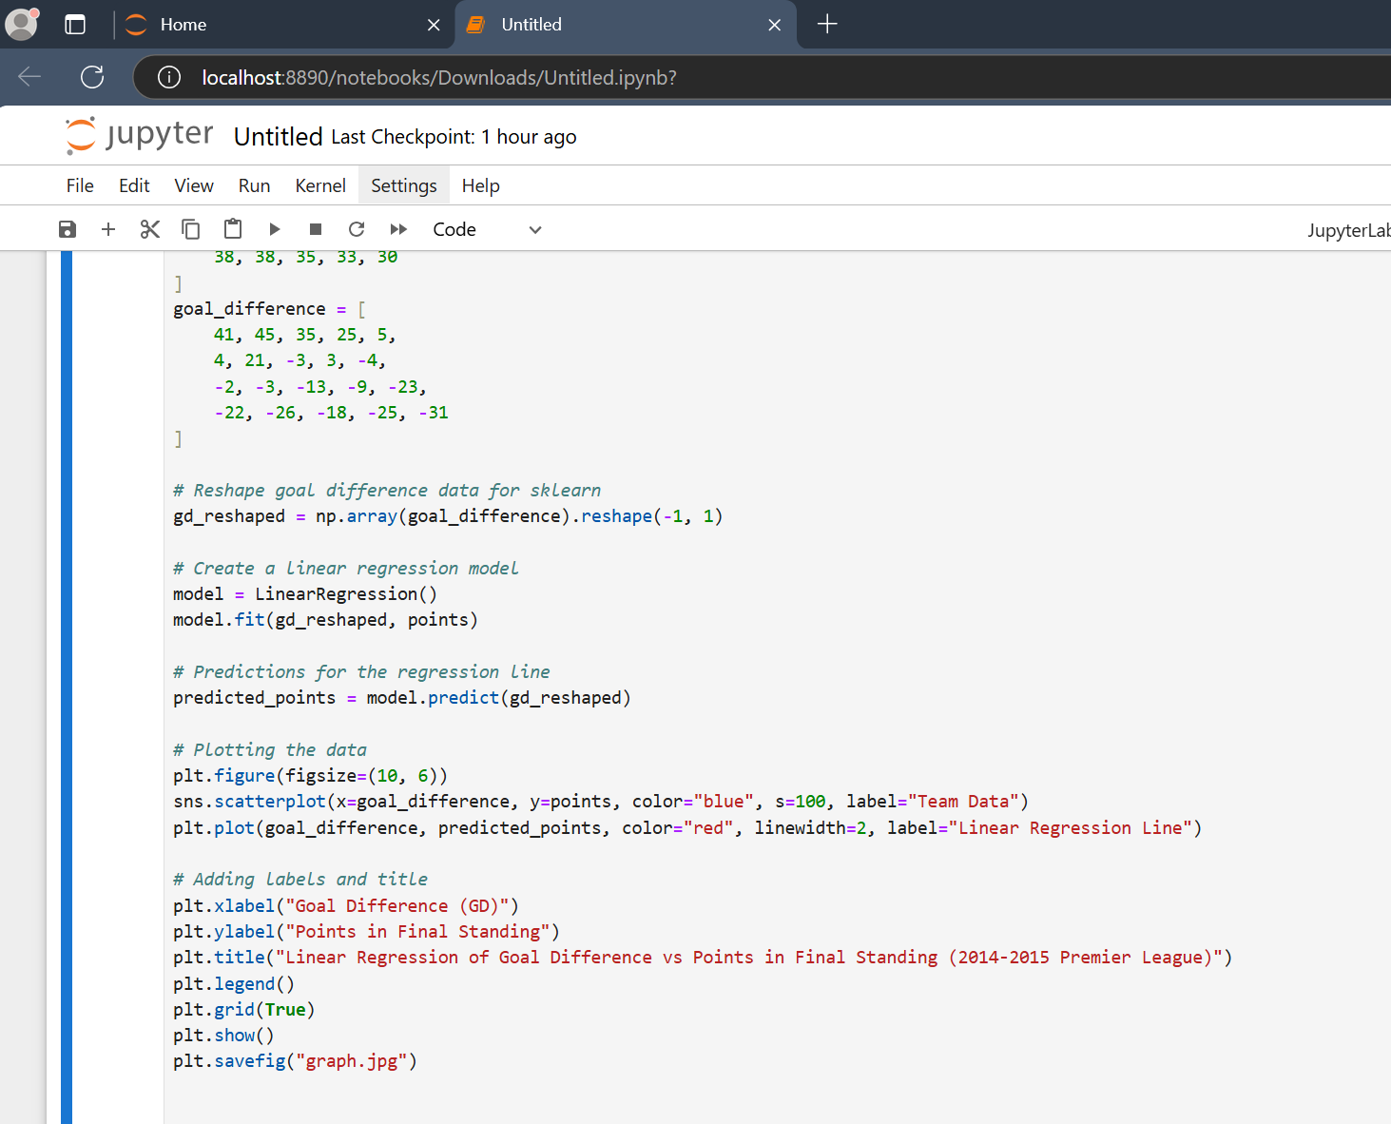

Linear Regression Dataset
Figure 5. Python Script

Slide 8
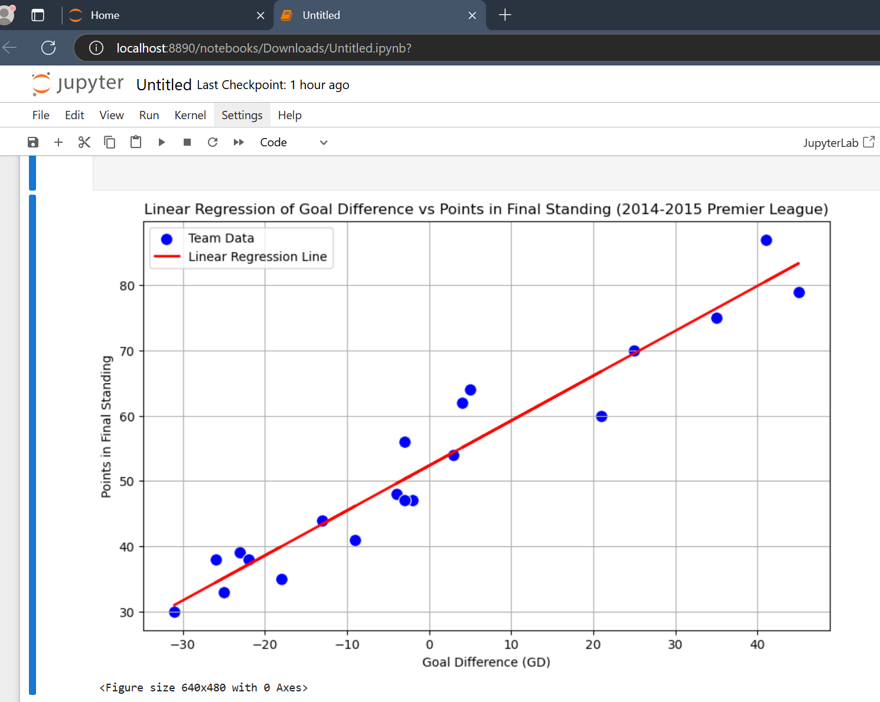
Linear Regression Dataset
Figure 6. Output

Slide 9
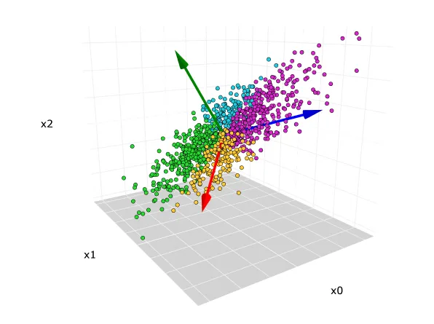
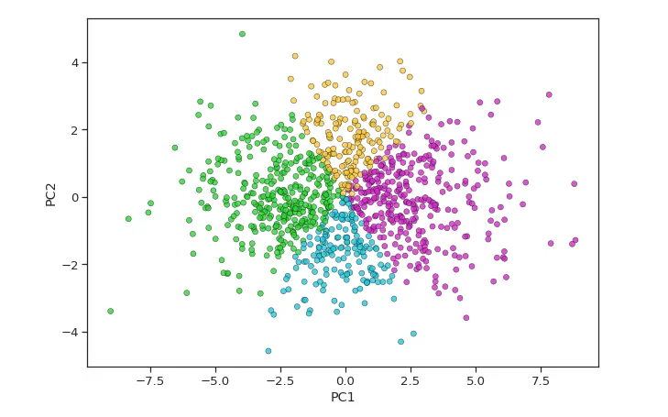
(Jaadi, 2024)
Principal Component Analysis (PCA)
Principal component analysis, or PCA, is a dimensionality reduction method that is often used to reduce the dimensionality of large data sets, by transforming a large set of variables into a smaller one that still contains most of the information in the large set (Jaadi, 2024).
This technique is very useful for machine learning models where there are multiple variables in a Dataset.
Reducing the number of variables of a data set naturally comes at the expense of accuracy, but the trick in dimensionality reduction is to trade a little accuracy for simplicity (Jaadi, 2024).
Figure 7&8 (Cheng, 2023)

Slide 10
Principal component analysis steps:
Standardize the Data: PCA requires the data to be standardized so that each variable contributes equally to the analysis. This step involves transforming the dataset so each variable has a mean of 0 and a standard deviation of 1. Standardization is critical when variables are on different scales (e.g., goals vs. tackles in football data), as PCA is sensitive to scale differences.
Compute the Covariance Matrix: After standardization, calculate the covariance matrix, which measures the relationships (covariances) between variables. This matrix captures how changes in one variable are associated with changes in another. In PCA, the covariance matrix helps to identify patterns and relationships between variables, which are important in reducing dimensions
Calculate Eigenvalues and Eigenvectors: Next, compute the eigenvalues and eigenvectors of the covariance matrix. Eigenvalues represent the magnitude of variance explained by each principal component, while eigenvectors indicate the direction of these components in the data space. The eigenvector with the highest eigenvalue represents the first principal component, explaining the most variance in the data.
Select Principal Components: Choose the principal components based on their eigenvalues. Typically, components with the highest eigenvalues (explaining the most variance) are retained, and lower-eigenvalue components are discarded. This step involves deciding how many components to keep, which is often determined by a threshold of total variance (e.g., retaining components that explain at least 95% of the variance).
Transform the Data: Finally, project the original standardized data onto the selected principal components to create a reduced-dimension dataset. This transformed data now has fewer dimensions but retains most of the original data’s variance. Analysts can use this lower-dimensional data for visualization, clustering, or input into machine-learning models.
PCA
Linear Regression
Neural Networks
Conclusion

Slide 11
Principal Component Analysis (PCA)
Limitations of PCA
Loss of Interpretability: While PCA reduces data dimensionality, the principal components themselves may be difficult to interpret. For instance, the first principal component might combine various unrelated metrics, making it less intuitive to understand (Jolliffe & Cadima, 2016).
Sensitivity to Scaling: PCA requires data to be standardized, especially when variables are measured on different scales (e.g., goals vs. sprint distance). If not, the results can be biased toward variables with larger scales, impacting the quality of insights derived from the analysis.
Focus on Linear Relationships: PCA only captures linear relationships between variables. In football, however, relationships between performance metrics can often be non-linear, which PCA may not effectively capture.
Potential Loss of Information: While PCA aims to retain as much variance as possible, reducing dimensions inherently means some data variation is lost, which could exclude minor but meaningful trends (James et al., 2013).

Slide 12
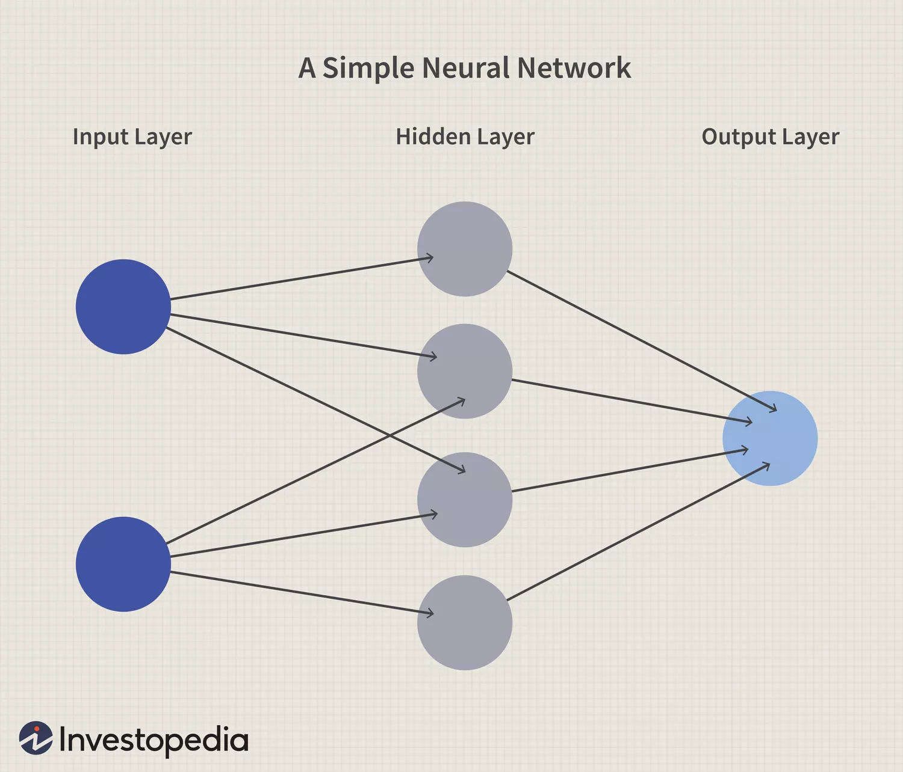
Neural Networks
What is a Neural Network?
A neural network is a series of algorithms that endeavors to recognize underlying relationships in a set of data through a process that mimics the way the human brain operates. In this sense, neural networks refer to systems of neurons, either organic or artificial in nature. (Chen, 2024)
Structures of Neural Network
Input Layers These layers receive data (e.g., stats like shots, goals, tackles)
Hidden Layers These layers process the data. Each neuron in a hidden layer applies a weight and activation function to the input, capturing complex patterns in the data.
Output Layer This final layer produces the network’s prediction (e.g., goal probability, win/loss)
Figure 9. (Chen, 2024)
Neural Networks
Linear Regression
PCA
Conclusion

Slide 13
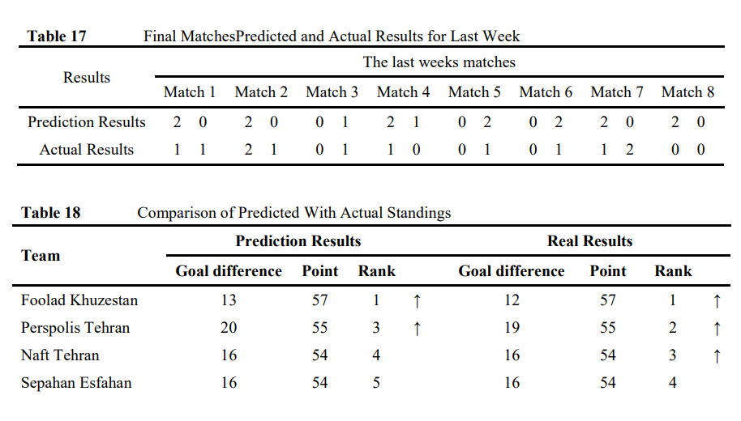
Examples
Predicted outcome of one game week of Iran Pro League 2013-14 football matches using Artificial Neural Networks.
Used Data from past matches of seven leagues.
Results showed that neural networks have a remarkable ability to predict the results of football match results.
Arabzad, S. Mohammad & Garbo, Marilyn & Soheil, Sadi-Nezhad & Ghofrani, Nooshin. (2014). Football Match Results Prediction Using Artificial Neural Networks; The Case of Iran Pro League.
Figure 10. (Arabzad, 2014)

Slide 14
Neural Networks
Limitations of PCA
Requires large Dataset It may work poorly when data don’t occur frequently. (E.g., Penalties, Red Cards)
Computational Intensity Expensive to train and deploy. Processing power, memory, and specialized hardware (such as GPUs) are often needed to handle large networks efficiently.
Risk of Overfitting Overfitting occurs when a model performs well on training data but poorly on new data
Need of expertise Building and maintaining neural networks requires specialized knowledge of machine learning and data engineering.

Slide 15
Summary
Here is what we learned
Linear Regression: Is a statistical technique to examine and determine a relation between a dependent and one or more independent variables.
Principal Component Analysis (PCA): A dimensionality-reducing technique that transforms large dataset into smaller sets of principal components for better readability.
Neural Networks: Designed models that learn complex patterns from large datasets through different layers to predict outcomes.
Conclusion
Linear Regression
PCA
Neural Networks

Slide 16
Catapult. (2024). What is Sports Analytics? The Power of Data in Sports. Retrieved from https://www.catapultsports.com/blog Kologlu, Y., Birinci, H., Kanalmaz, S. I., & Ozyilmaz, B. (2018). A Multiple Linear Regression Approach For Estimating the Market Value of Football Players in Forward Position. ArXiv. https://arxiv.org/abs/1807.01104 kassambara, (2018). Simple Linear Regression in R [online] Available at: http://www.sthda.com/english/articles/40-regression-analysis/167-simple-linear-regression-in-r/#regression-line Wong, J. (2021, December 16). Linear regression explained - towards data science. Medium. https://towardsdatascience.com/linear-regression-explained-1b36f97b7572 Gopalan, B. (2020, September 8). What is “Line of Best fit” in linear regression? Numpy Ninja. Retrieved November 11, 2024, from https://www.numpyninja.com/post/what-is-line-of-best-fit-in-linear-regression Kavita. (2024, September 30). Linear Regression: A Comprehensive guide. Analytics Vidhya. https://www.analyticsvidhya.com/blog/2021/10/everything-you-need-to-know-about-linear-regression/#:~:text=The%20best%2Dfit%20line%20is,find%20the%20best%20fit%20line.
References

Slide 17
Jaadi, Z. (2024, February 23). Principal Component Analysis (PCA): A Step-by-Step Explanation. Built In. https://builtin.com/data-science/step-step-explanation-principal-component-analysis Cheng, C. (2023, May 6). Principal Component Analysis (PCA) Explained Visually with Zero Math. Medium. https://towardsdatascience.com/principal-component-analysis-pca-explained-visually-with-zero-math-1cbf392b9e7d James, G., Witten, D., Hastie, T., & Tibshirani, R. (2013). An Introduction to Statistical Learning: With Applications in R. Jolliffe, I. T., & Cadima, J. (2016). Principal Component Analysis: A Review and Recent Developments. Phil. Trans. R. Soc. Chen, J. (2024, July 28). What is a neural network? Investopedia. https://www.investopedia.com/terms/n/neuralnetwork.asp Arabzad, S. Mohammad & Garbo, Marilyn & Soheil, Sadi-Nezhad & Ghofrani, Nooshin. (2014). Football Match Results Prediction Using Artificial Neural Networks; The Case of Iran Pro League. International Journal of Applied Research on Industrial Engineering. 1. 159-179.

